Slide 1

Pandemic Publishing Trends
Ayan Ajanaku
Ciin Cing
Jasmine Blakley

Slide 2
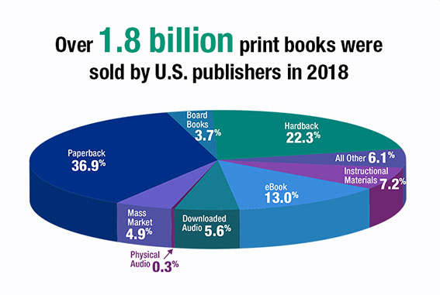
Notes:
The global book publishing industry accounts for over $100 billion of annual revenue.

Slide 3

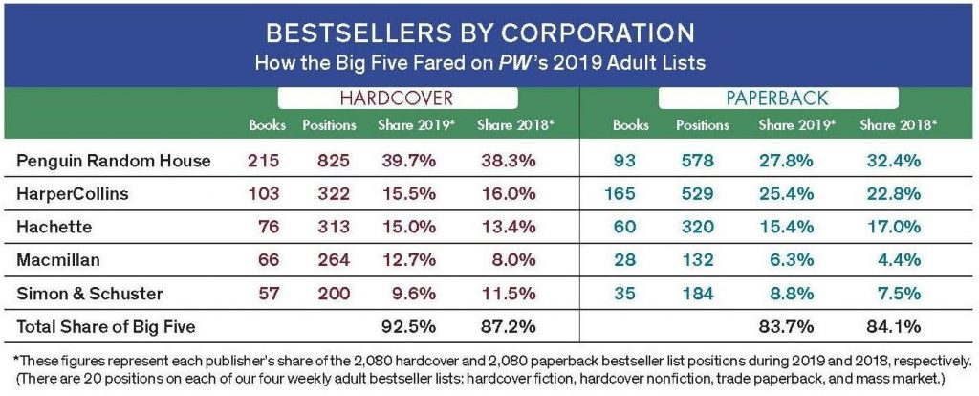



Fast facts: Approximately 60% of English-language books are produced through the "Big Five" publishing houses. Amazon accounts for nearly 50% of all book sales. Publishers are forced to give Amazon significant discounts, which independent bookstores can’t compete with. There were 5,500 independent bookstores in 7,000 locations in the United States in 1995, the year Amazon started its business. As of 2022, only 2,023 independent bookstores in 2,506
Notes:
Read slides... “In short, always patronize your local independent bookstore when possible!”

Slide 4
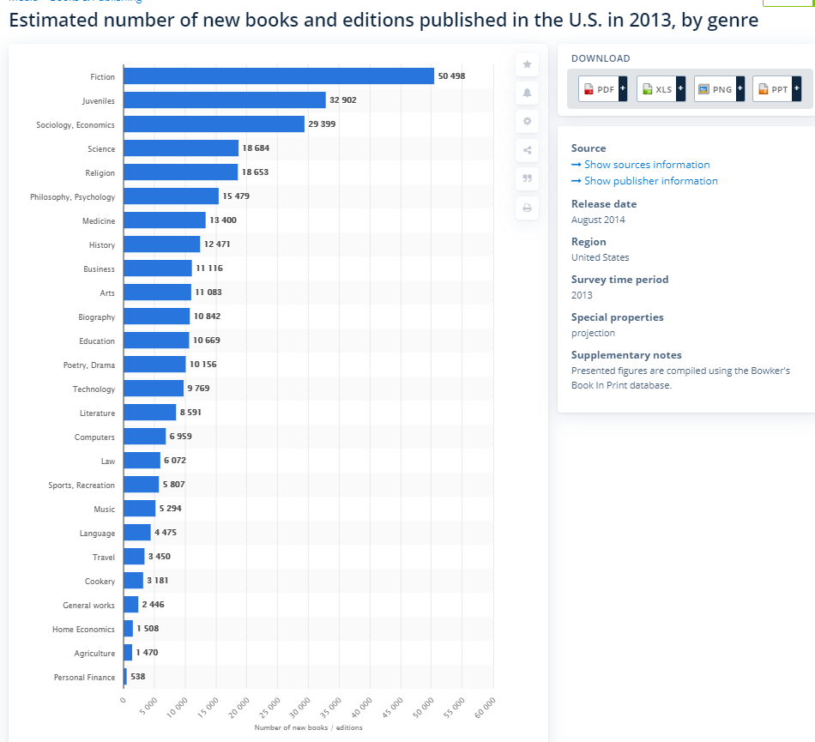
Most Popular Genres
Notes:
Historically these are some of the most popular genres as far as sales and publication counts are concerned. We weren’t sure if these genres might have changed during the pandemic which ignited some of our curiosity.

Slide 5

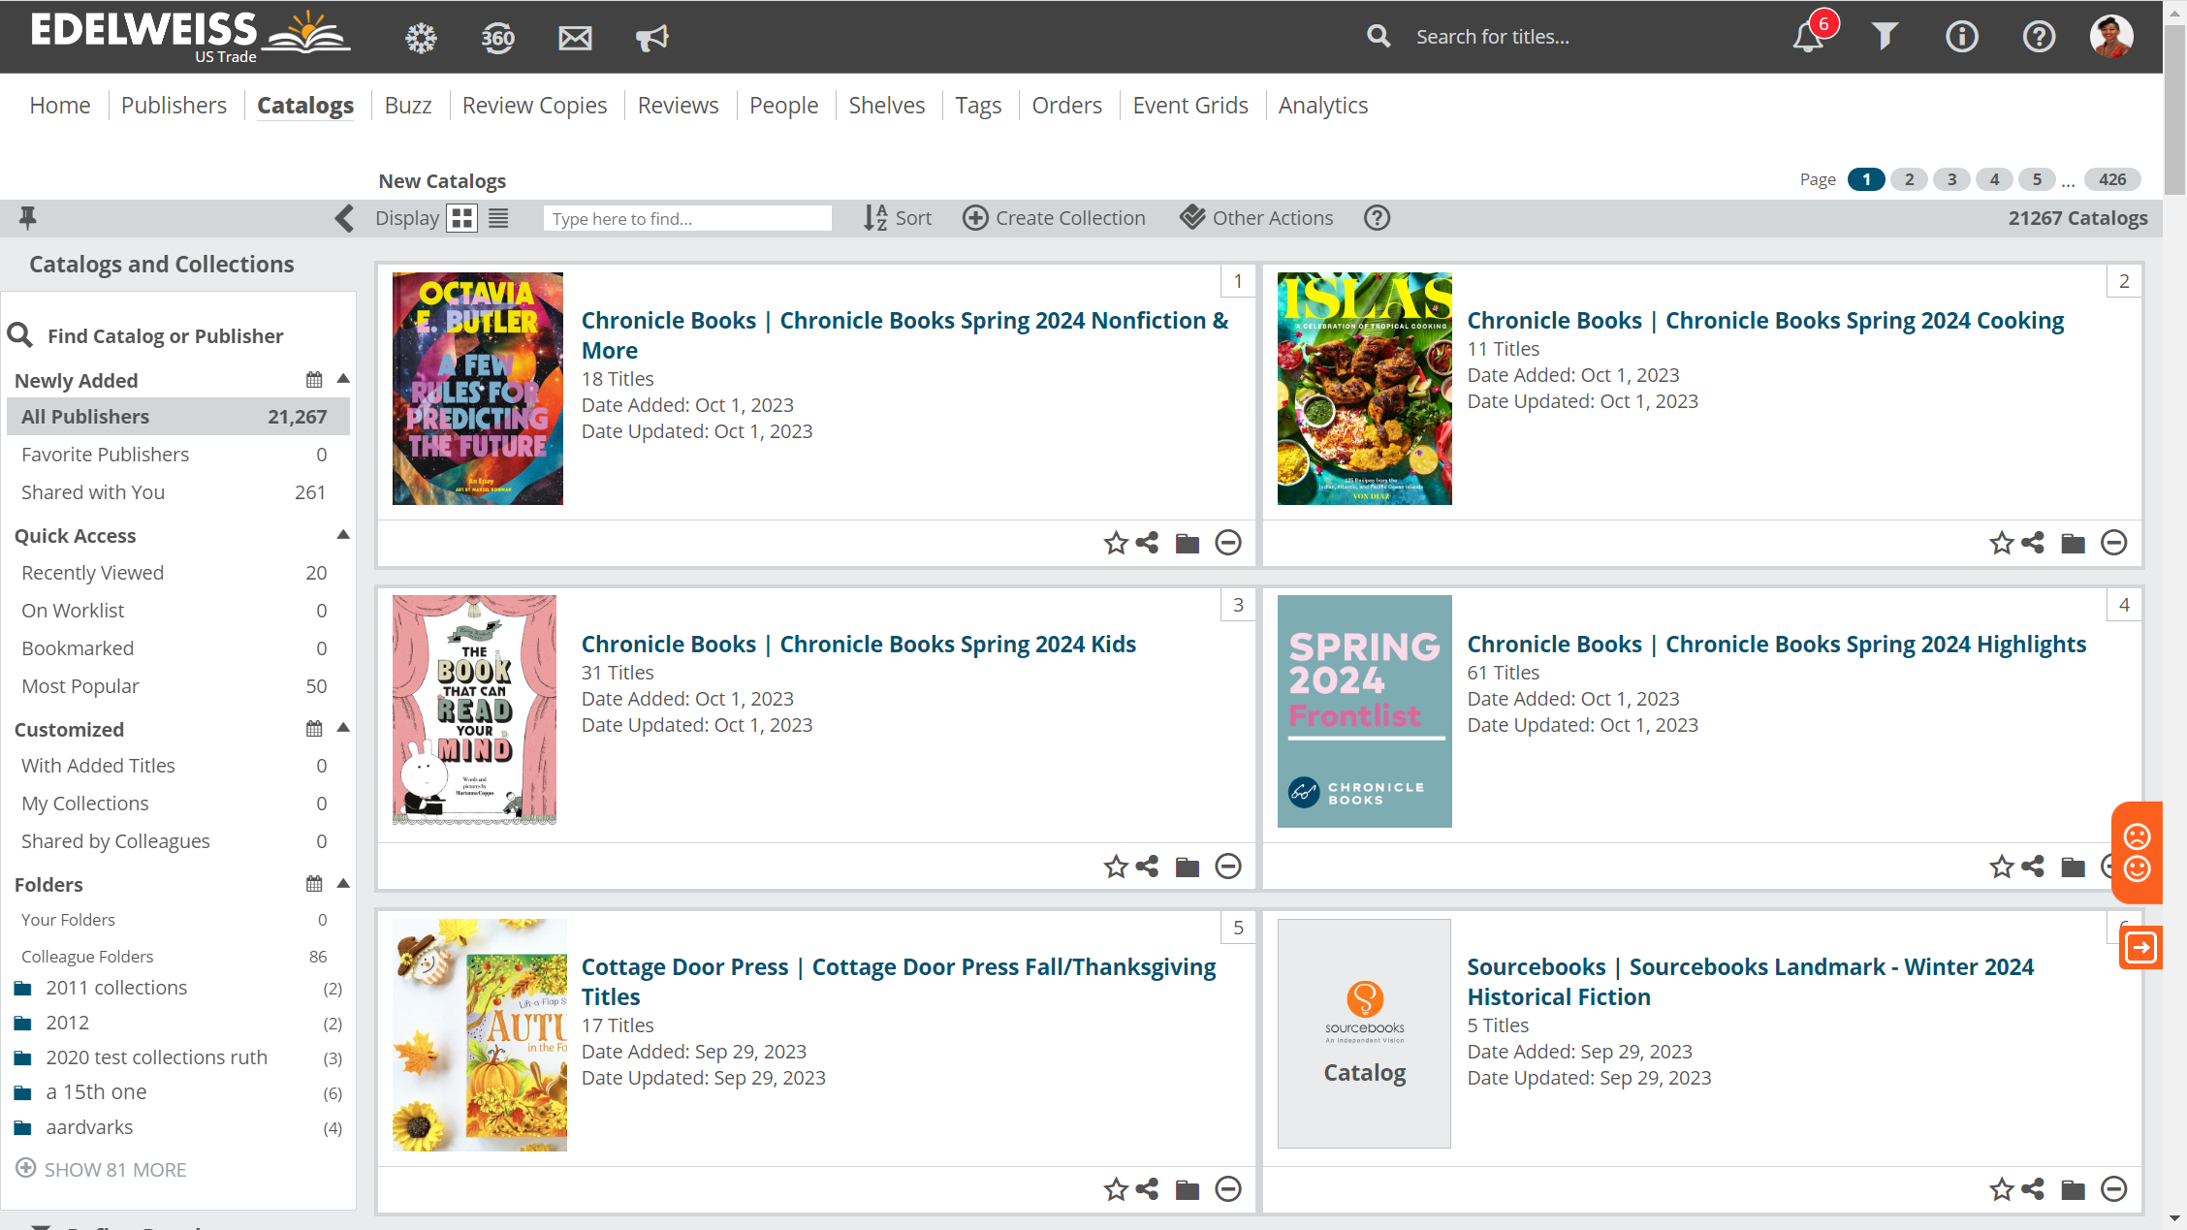
B2B Publishing Sales
Publishers use a platform called Edelweiss to market and sell their titles to businesses.
Industry professionals like retailers, bloggers, booksellers, librarians, publishers, academics and writers use the platform to learn about, review and order books.
Notes:
I work for this small technology company called Edelweiss.

Slide 6

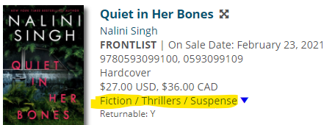
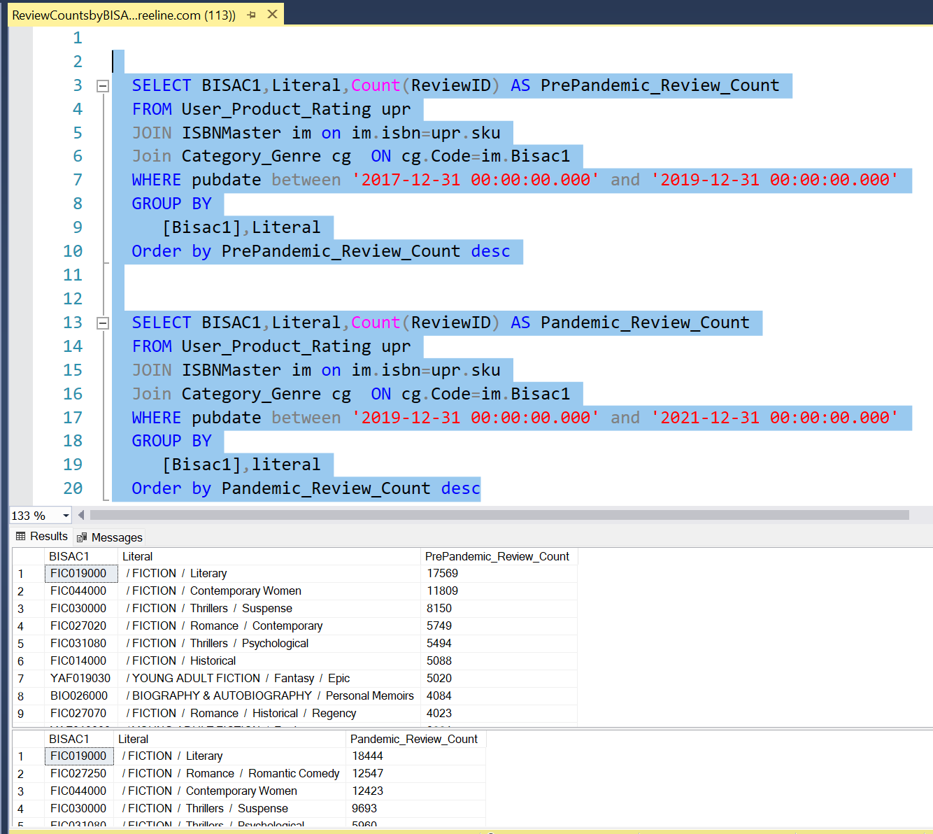
Data Gathering
Edelweiss houses publisher title metadata such as basic title data and marketing assets.
I used SQL queries in SSMS to gather data from Edelweiss databases that I thought could be interesting.
I initially created about 13 tables which we turned into CSVs. We separated pre-pandemic and pandemic data for various interest points. Once the data was in a Jupyter notebook we merged pre pandemic and pandemic.
Notes:
Metadata is all the data related to a title
ONIX - An XML-based standard for rich book metadata, providing a consistent way for publishers, retailers and their supply chain partners to communicate rich information about their products.

Slide 7
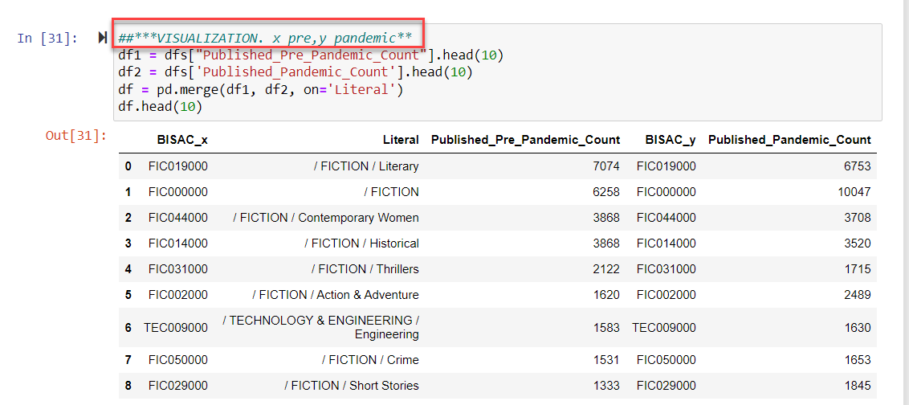
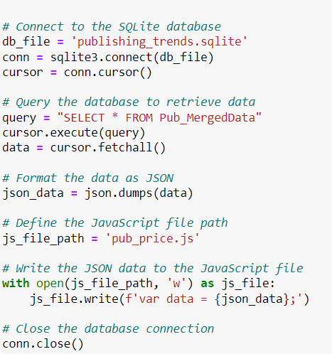
Data Cleaning & Exploration
We moved the CSVs into a SQL lite database.
We then created various plots and tables to decide which pieces of data were of most interest. We also removed null values.
We decided during this phase that we would sort and focus our analysis on retail prices, user types, and genre counts.
I connected to SQL lite database, formatted the data as JSON and wrote the JSON data to JavaScript files which were handed off to Ciin in the form of JavaScript files.
While Ciin was working on the plots I wrote the code for the Flask API and found a basic template online for the index.html which I began putting together.

Slide 8
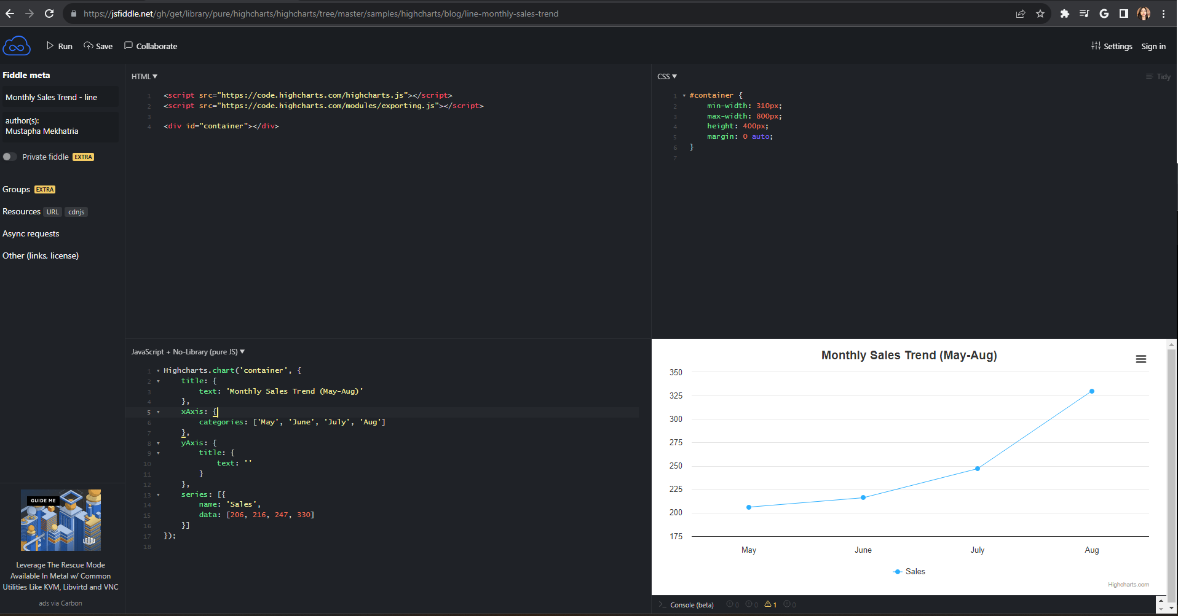
Notes:
Next, it was Jasmine’s turn to create the other HTML pages, while I created the JavaScript code for these visualizations. It was difficult at first because without HTML pages I wasn’t able to visualize these charts, but I was able to find a website that could put everything together called JSFiddle. On this application, you can enter the HTML, CSS, and JavaScript and visualize it. That way, I was able to play around with dummy data while Jasmine was working on the index.

Slide 9
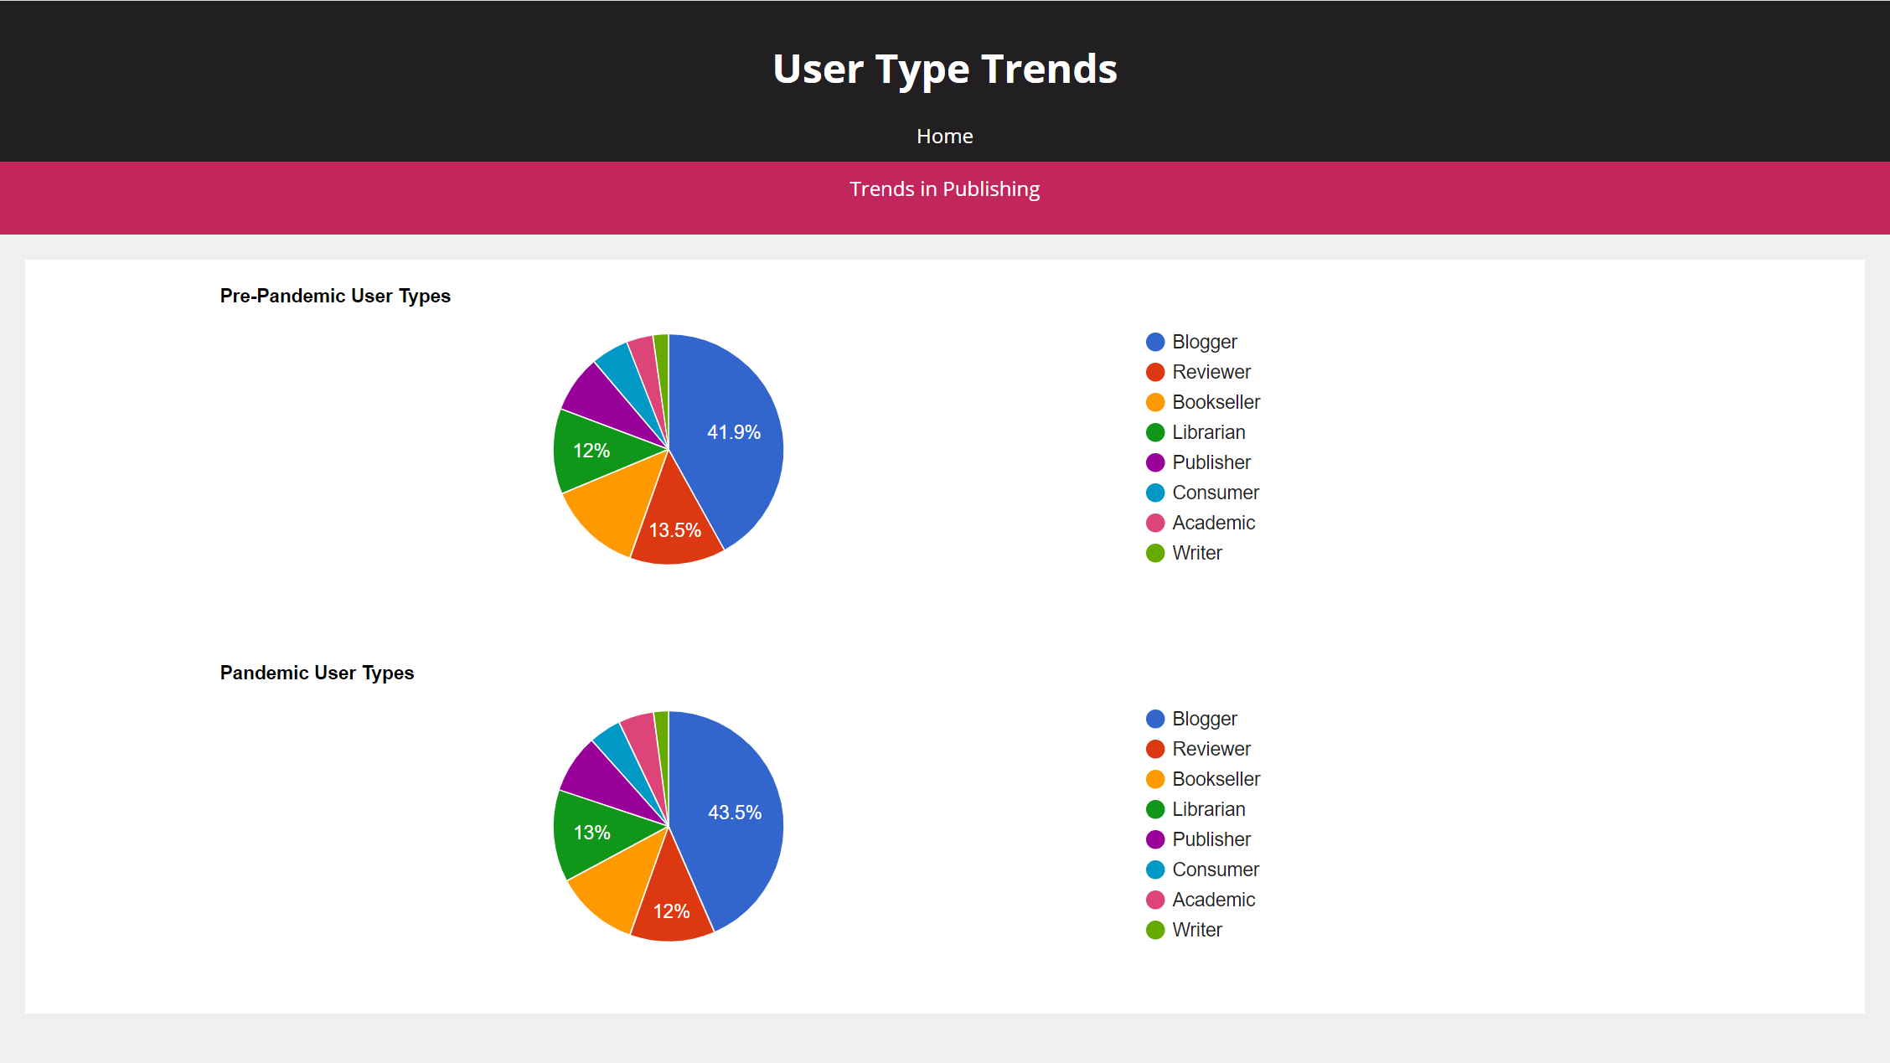
Notes:
The first visualization we created is a pie chart using Google Charts as a library. These pie charts are about the different users of Edelweiss (ay·duhl·vise) before the pandemic and during the pandemic. We noticed that bloggers are the most common user type at 41.9% which rises to 43.5% during the pandemic. There are significantly more bloggers than reviewers or book sellers because they are individuals, while other user types often represent themselves as a business or school. The vast majority of bloggers and reviewers are social media influencers on bookstagram or book tok who use Edelweiss to learn about books and review them. And you can’t see it on this PowerPoint, but booksellers are the only user type category that decreased in number during the pandemic, from 13% to 11%, most likely due to the obvious challenges of having to close their doors and compete directly with Amazon through online ordering.

Slide 10
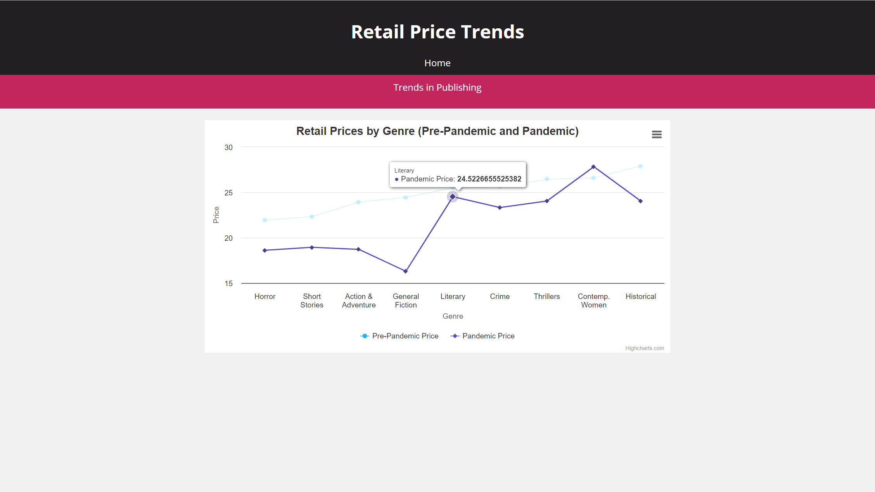
Notes:
The next visualization is a line chart done by HighCharts. This shows the average retail price for each genre, both pre-pandemic and during pandemic. Generally, prices will rise due to inflation but in this case, retail prices were lower during the pandemic than before. As to why store prices lowered, there could so many reasons, from increased competition, to consumers being more price-sensitive, or e-book sales because e-books are cheaper. But as to the exact reason why the shift happened, we unfortunately have no clue.

Slide 11
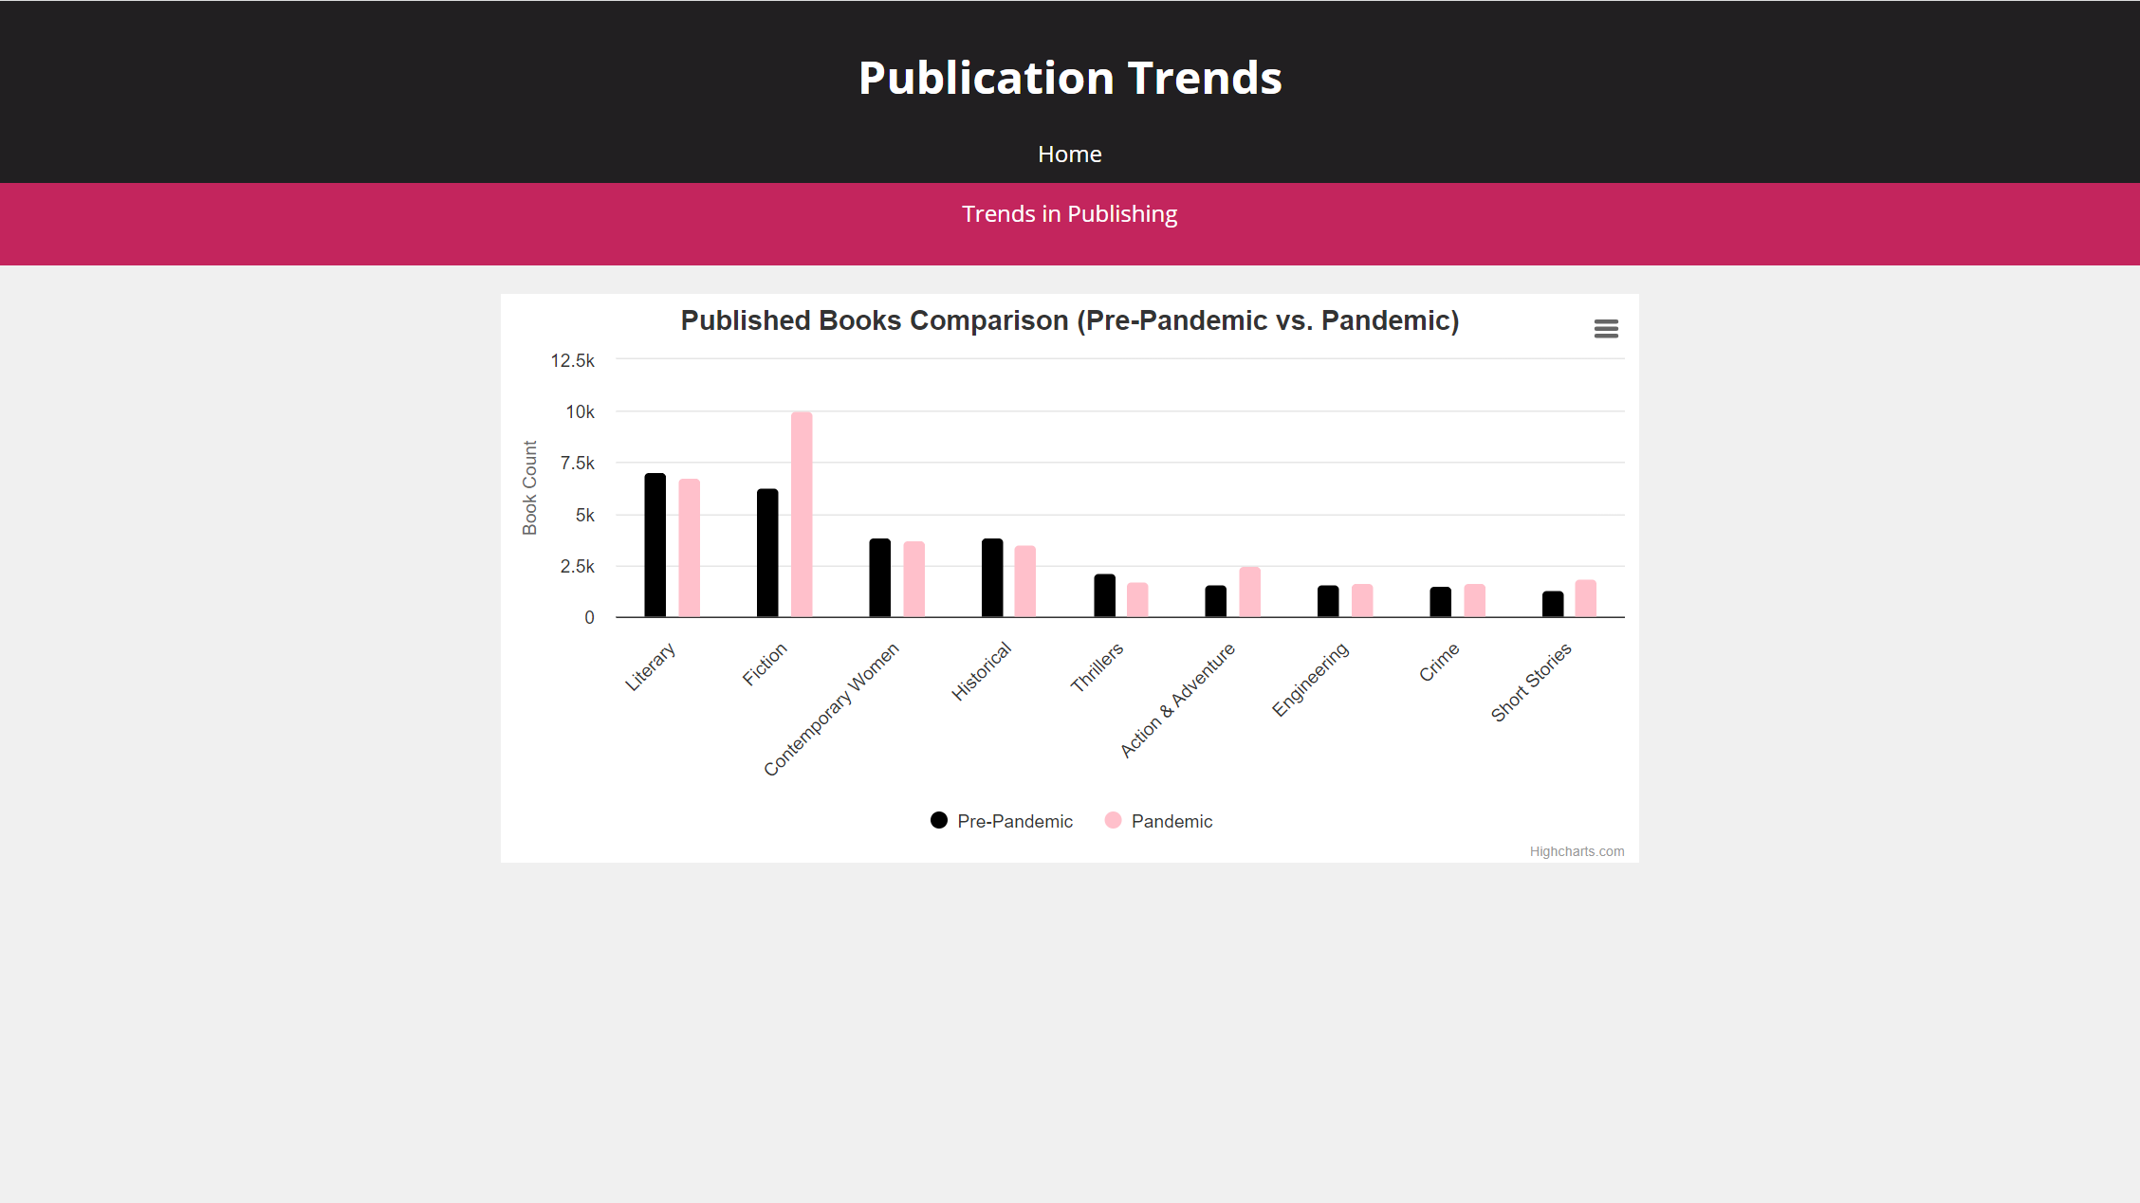
Notes:
This is bar chart also created through High Charts about the number of published books before and during the pandemic. Fiction and Literary are at the top at 6000 and 7000 before the pandemic, and 6000 and 10,000 during the pandemic. It’s also important to note that fiction has many subcategories. We see that there was an incredible spike in Adult General Fiction overall during the pandemic, which told us that category was still holding strong.

Slide 12
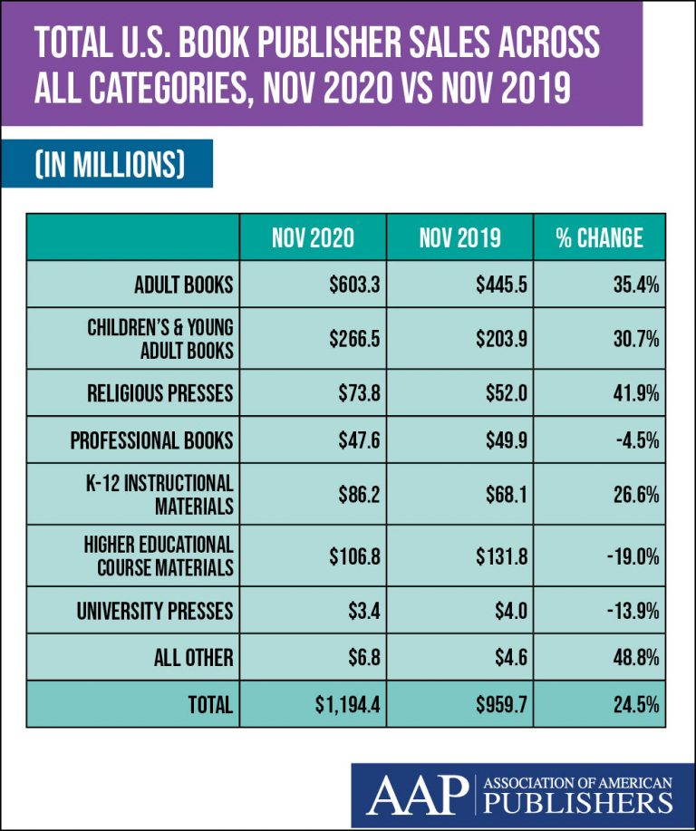
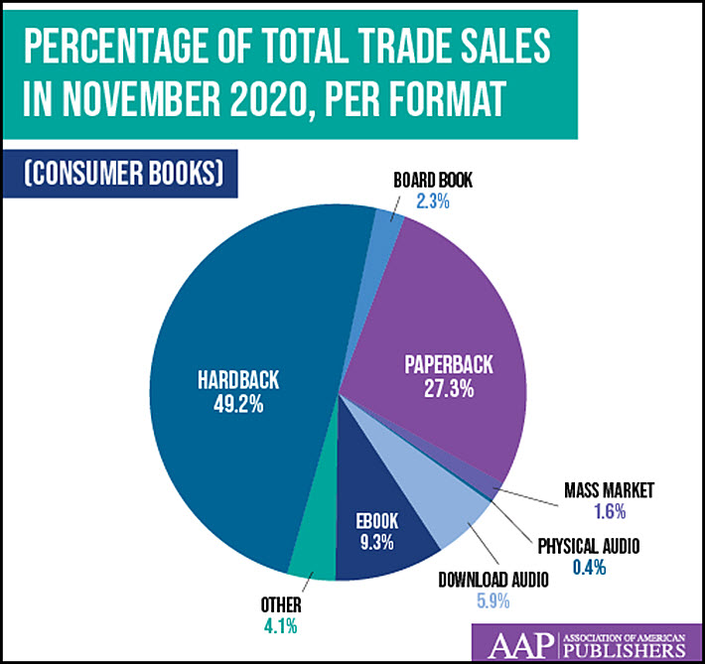
Notes:
Looking at these statistics there was obviously significant growth in the industry during the pandemic. As you can see, adult books, children's books, and religious presses had major increases. But professional books and higher education materials dropped, probably due to the fact that there wasn’t really a school to go back to. Also, this information wasn’t pulled from Edelweiss, they were from the Association of American Publishers, but given more time this is an area we would explore. We just thought it would be helpful to visualize and understand how the industry grew.

Slide 13
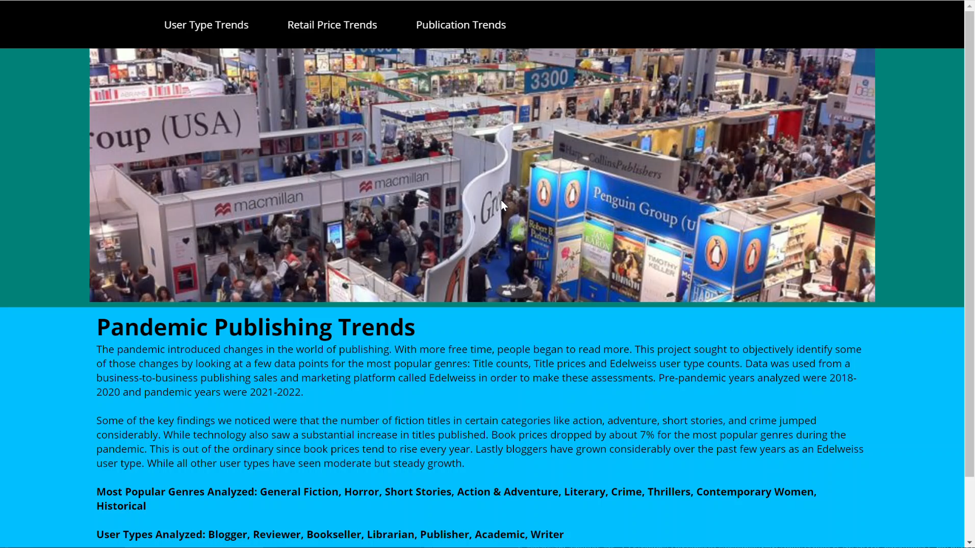

Slide 14

This concludes our presentation on Trends In Publishing
Questions?
References: Association of American Publishers, Wordsrated.com "Impact of Amazon On The Publishing Industry" and Publishers Weekly

